Slide 1


Dow-Key Space Product Overview

Slide 2
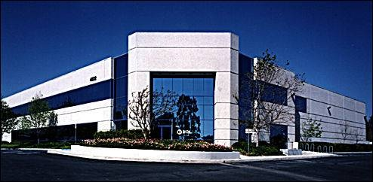
AS9100 and ISO 9001:2008
DOD Facility Security (Secret)
Ventura California, USA

Slide 3
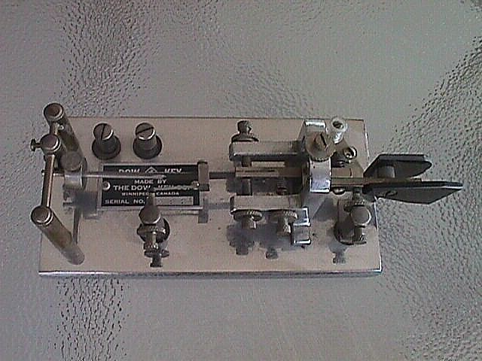
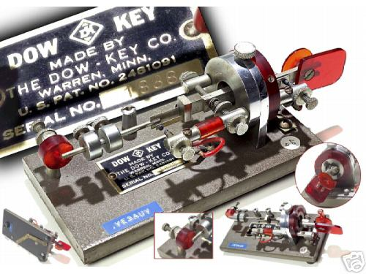
Microwave Switch Business Since 1946
This is a view of the bug, Paul Dow’s
titled Dow Key

Slide 4
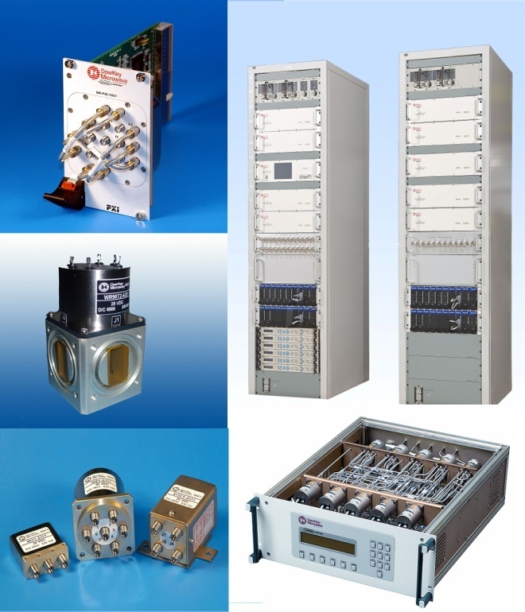
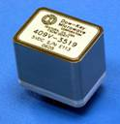
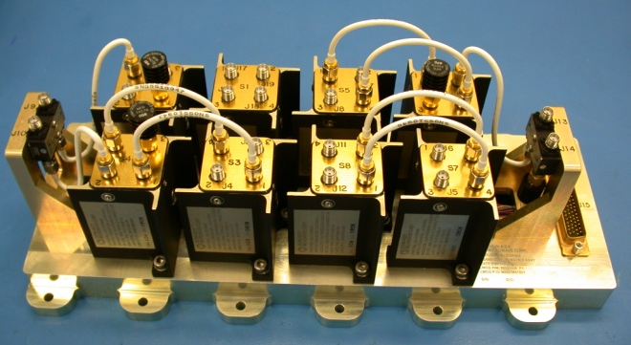
Your Switch SolutionTM
Dow-Key Organization
Switches
  Electromechanical Coaxial Switches from DC to 40GHz
  Miniaturized PCB Mounted Switches
  Waveguide Switches up to 70GHz
Space Qualified Switches
  Switches
  Switch Assemblies
Switching Systems
  Solid State Matrix Systems from HF to S-Band
  Electromechanical Matrix Systems from DC to 40GHz
  Custom Solutions and Full Integration

Slide 5
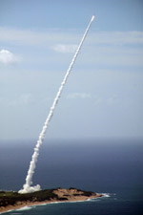
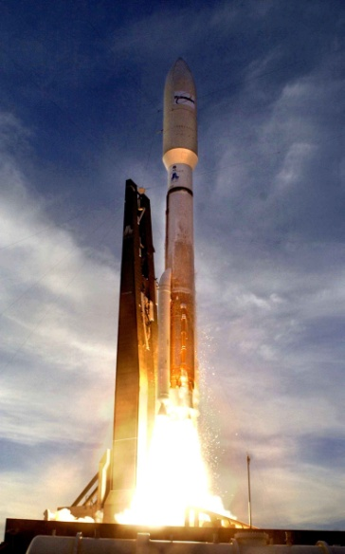


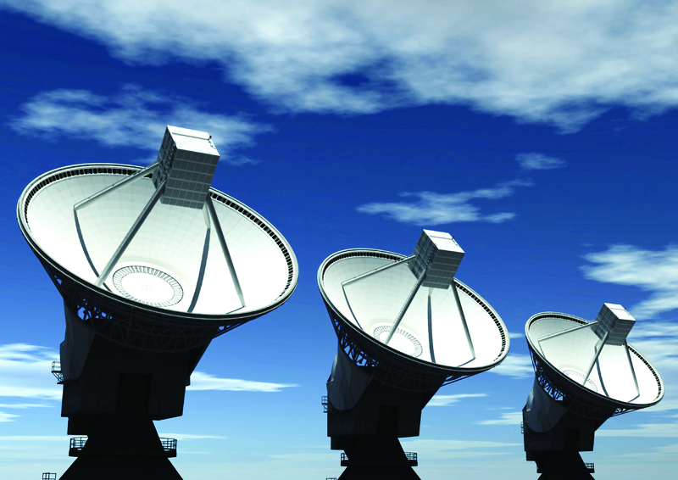
Military/Space Applications
Satellites and Launch Vehicles
Missile Defense
Avionics
ATE
SIGINT/SATCOM
EW

Slide 6
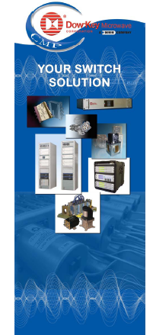
Major Customers
Surrey Satellite Technology LTD
Lockheed Space Systems
Boeing Space Systems
Orbital
Russian Space Systems
Ball Aerospace
NT Space
ISRO
Astrium
Thales Alenia Space
Northrop Grumman Aerospace

Slide 7
DKM Organization
Alan Anderson
General Manager
Mark Mandrell
Controller
Bill Frederick
IT Manager
Krzysztof Ciezarek
VP Engineering
Michael Turner
Director of Supply Chain
Adolf Cheung
VP Sales & Marketing
Amber Albrecht
SR HR Generalist
Scott Wightman
Manufacturing Manager
Guy Yamashige
Space Products Program Manager
Geoff Wakefield
Manager of Quality Acting

Slide 8
Space Products Focus Factory
Guy Yamashige
Space Products Program Manager
Robert Collins
Assistant Program Manager
Trent Stewart
Production Supervisor
Margarita Reyes
Assembly Lead
Arturo Garcia
Test Technician
Virginia Caliboso
Soldier
Rosa Horta
Soldier
Danny Bobes
Assembler
Carmen Tovar
Soldier
Laura Fernandez
Assembler
Lenny
Assembler
Ruben Gonzalez
Mfg Engineer
Sharon Lynch
Space Products
QA Specialist
Vince Harter
Space Products
Technical sales Manager
Lavinia Bertsch
Sr. Procurement
Planning Specialist
Gary Witts
Sr. Projects and
Design Engineer
Scott Hickman
Sr. Projects Engineer
Ing Lu
Sr. Projects Engineer
Mark Nelson
Test
Engineering Supervisor
Gordon Grant
Space Test Technician
Jeff Jue
Space Test Technician
Keith Parker
Space Test Technician
OPEN
Space Test Technician

Slide 9
Export Control
Export Control Procedure
Technology Control Part
DKM Export Control Group
SCD ITAR Marking
Export Classification Check List Process (ITAR, EAR, ECCN)
Marketing License for Europe and ASIA
Dover and Internal Training
Dover and Dow-Key Audits

Slide 10
Space Products
Space Products Focus Factory
  Cleanroom Assembly: 9
  Design Engineering (Full time) 4
  Designer 1
  Jr. Engineers (new) 2
  Manufacturing Engineering: 1
  Program Management: 2
  Quality Assurance: 3
  Buyer/Planer: 1
  Technical Marketing: 1
  Test: 5
  Total personnel: 29

Slide 11

Engineering Organization Chart
Krzysztof Ciezarek
Vice President of Engineering
Digital, Software & RF
Engineering
New Product Development
Mechanical Engineering
Space & Switch Product Engineering
Terry Johnson
Mechanical Engineer
Space Engineering
Giuseppe Bondi
Engineering Manager
Garland Nicklaus
Engineering Manager
Gary Witts
Senior Engineer
Yung Chu
RF Engineer
Ed DeLaCruz
Designer
Sustaining
Switch Engineering
Sara Lee
Electrical Engineer
Ing Lu
Senior Project Engineer
Thom Thomas
Sr. Digital Engineer
Jerry Droney
Manufacturing Engineer
Scott Hickman
Senior Project Engineer
Paul Hudson
Mechanical Engineer
(50%)
Mathew Cheung
Intern ME
Roberto Ferretti
Software Engineer
Bill Larrick
Digital Engineer
Document Control
Kelly Romanowsky
Document Control
Chris Navarro
Clerk (50%)
Notes:
11

Slide 12
Engineering Tools
Mechanical Engineering
  SolidWorks
    3D Design
      SolidWorks Premium
    Simulation
      SolidWorks Simulation Professional
    Data Management
      SolidWorks Enterprise PDM

Slide 13
Engineering Tools
Electrical Engineering
  Electromagnetic Field Simulation
    Low Frequency (for Actuators)
      Infolytica MagNet
    High Frequency (for RF/Microwave Structures)
      HFSS
  RF/Microwave PCB Level Design
      Microwave Office
Test Engineering
  LabView

Slide 14
Capacity
Current Capacity:
  Currently Producing 52 Hi-Rel Switches + one Switch Block assembly per Month.
  Capacity without changes is 75-80 switches per Month + two Switch Block assemblies
  Clean room Day Shift Capacity operating at 65%
  Test Lab currently operating 1 ¾ shifts
  Third shift available as needed
  Second and Third Shift personnel & resources if required
Add Capacity
  80-150 switch per month.
    Second Clean room shift required
    Third Test Lab shift as required
    Another T-Vac Station

Slide 15
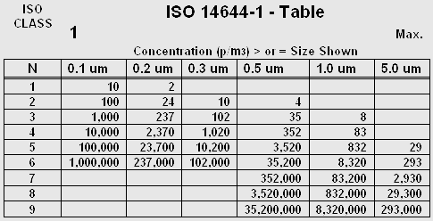
Personnel and Training
All personnel that perform work, inspect or handle flight hardware are required to receive the appropriate training and maintain all required certifications per J-STD-001 and NASA-STD-8739.3.
Qualifications include:
  Foreign Object Elimination
  ESD Training
Certifications include:
    Solder Process
    J-STD-001(S)
    NASA-STD-8739.3
Clean Room Certification include:
  ISO-14644 Class 7, annual certification
  Flow Benches – ISO-14655 Class 5, semi-annual certification

Slide 16
Environmental Testing
Test Engineering Staffing
1Test Engineer Supervisor
4 Test Technicians
2 shifts
  technicians per shift
All Test personnel have a minimum of 10 years experience.
Overtime and automation are used to cover 24 hour testing when required.

Slide 17
Environmental Testing
Test Equipment
Thermal Vacuum Chambers (3)
  10⁻⁶ torr typical vacuum
  -60C to +90C
Temperature Chambers (3 Hi-Rel) +3
  -60C to +125C
Thermal Shock Chamber
  -60C to +125C
  MIL-STD-202 Compliant

Slide 18
Environmental Testing
Test Equipment
Multipaction Station (1)
UHF (500W)
L-Band (1,200W)
S-Band (125W)
X-Band (100W)

Slide 19
Environmental Testing
Test Equipment (continued)
Vibration System
    5 – 3000 Hz
    Sine and Random Vibration
    Chatter Detection (MIL-STD-202)
RF Parameters
    65 GHz
    Full ‘S’ Parameters
DC Parameters
    Voltage, Current and Resistance
    Timing

Slide 20

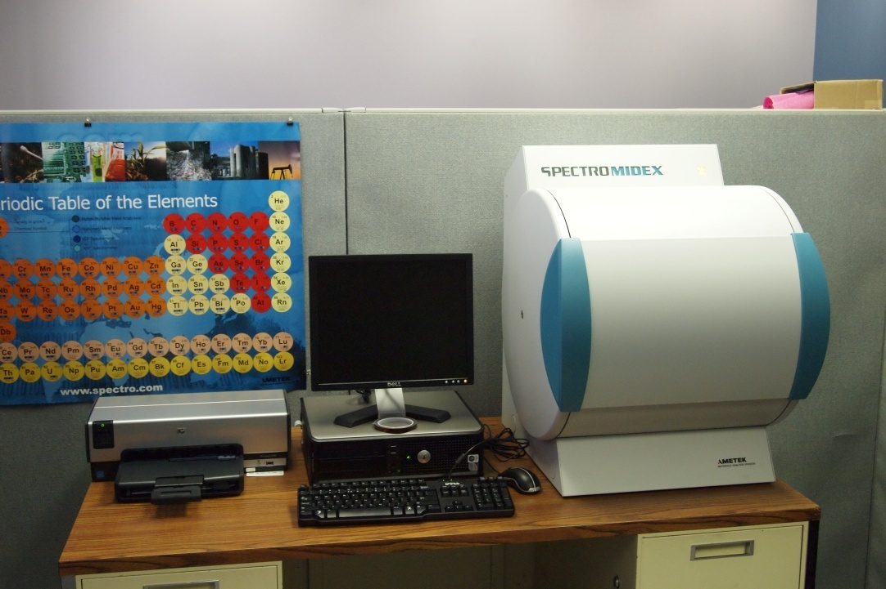
Specialized Equipment and Training
Prohibit Material Screening Chamber

Slide 21
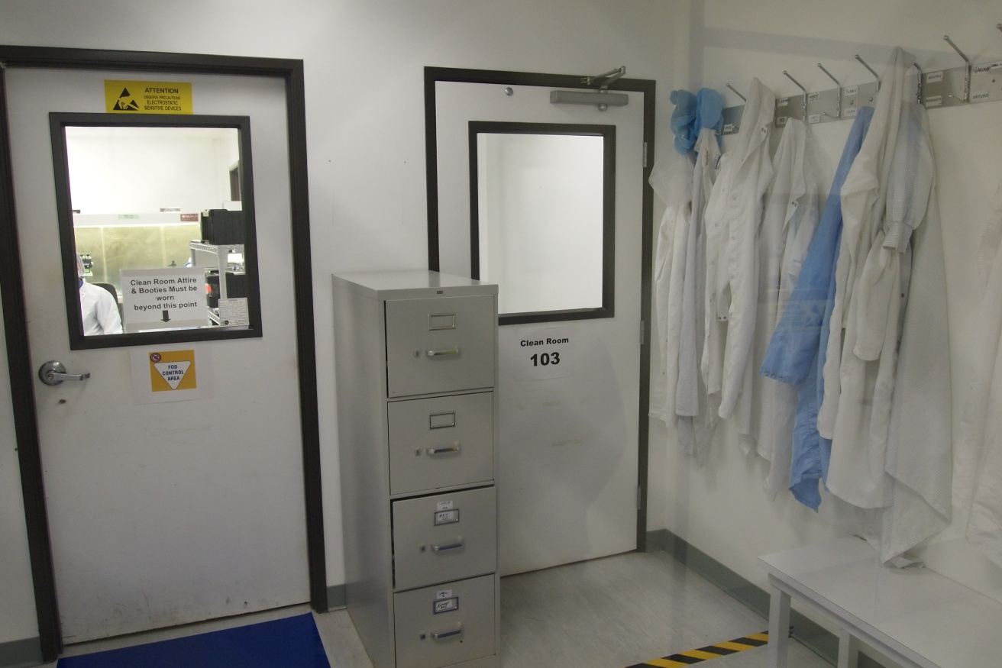
Dow-Key Microwave is operating two Class 7 Clean Rooms
Each equipped with class 5 laminar Flow Benches.
Technicians that perform solder operations are certified to
NASA standard 8739.3 and IPC J-STD-001.
Entrance to Clean Rooms

Slide 22
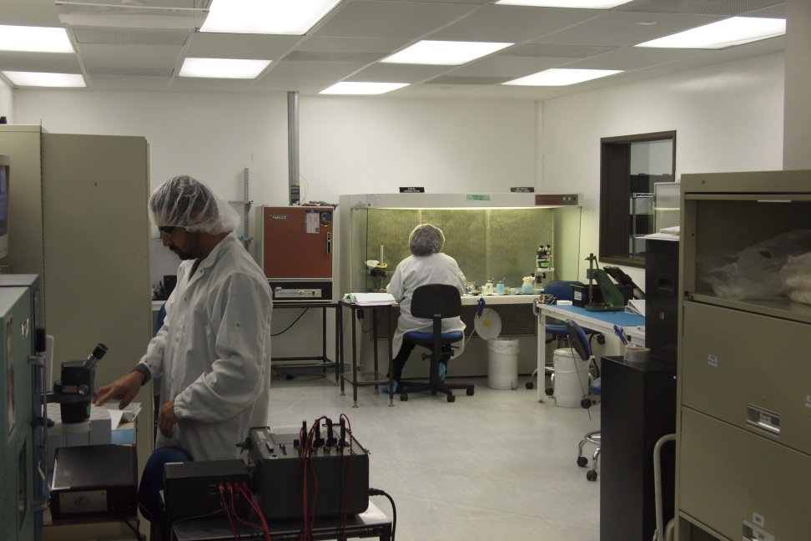
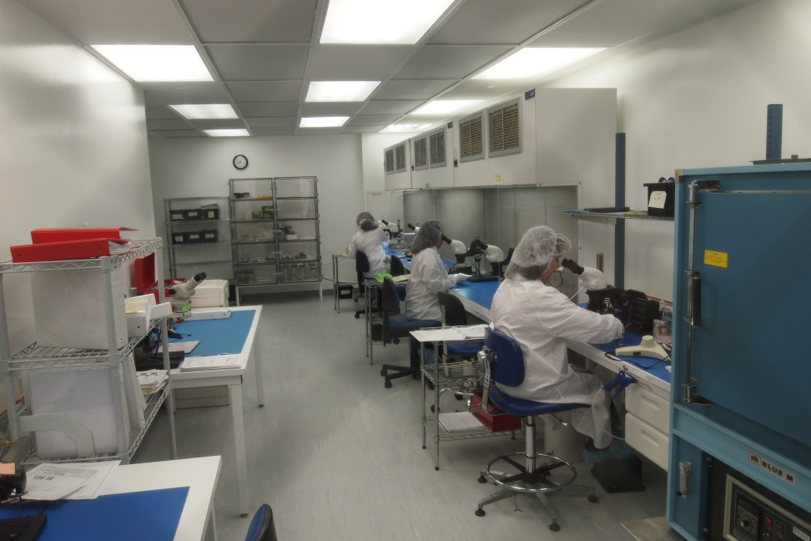
Clean Rooms #102 and #103

Slide 23
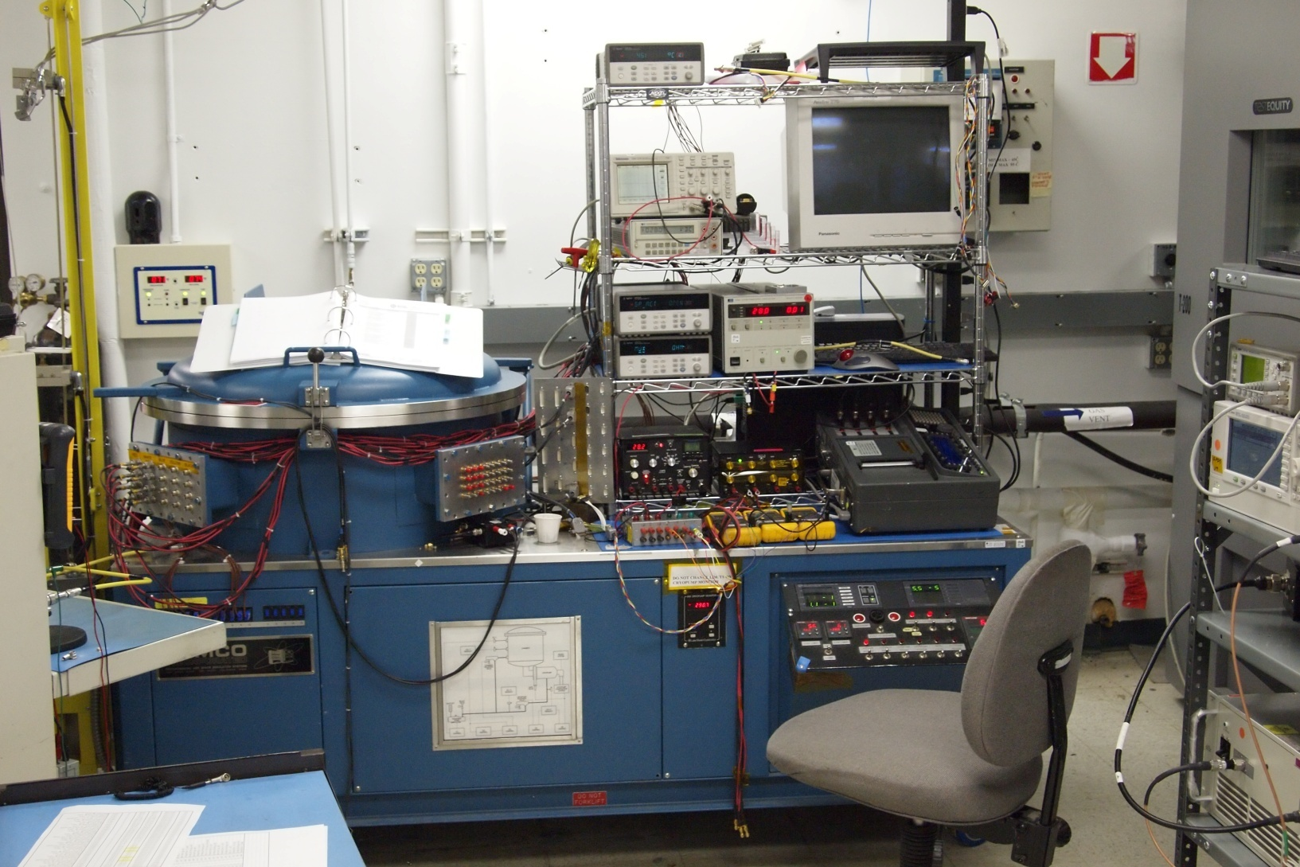
Thermal Vacuum

Slide 24
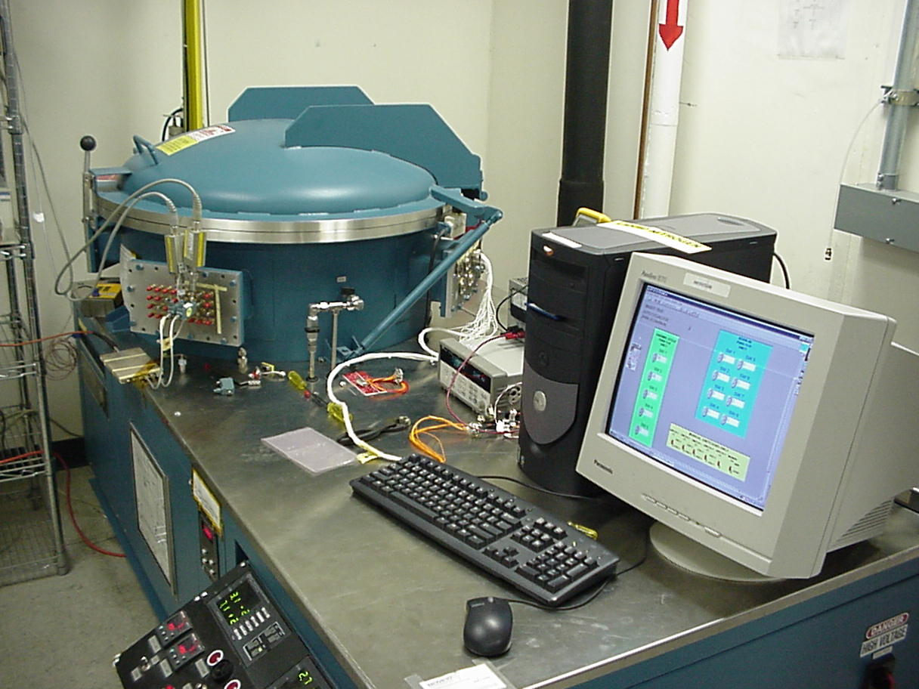
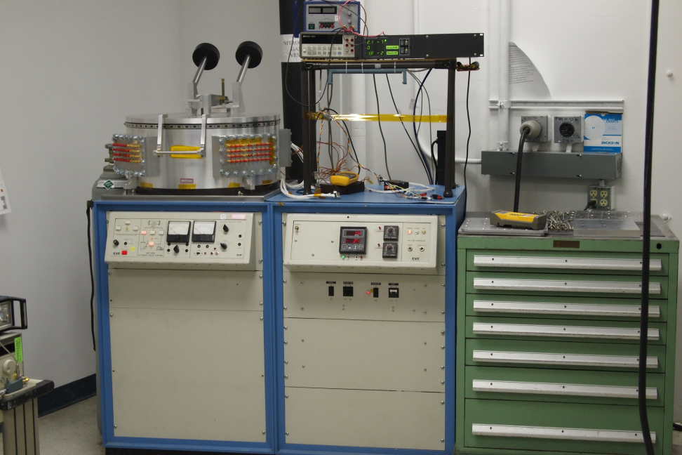
Thermal Vacuum Cycling
Station #3 on order, delivery schedule for May
Station #2
Station #3

Slide 25
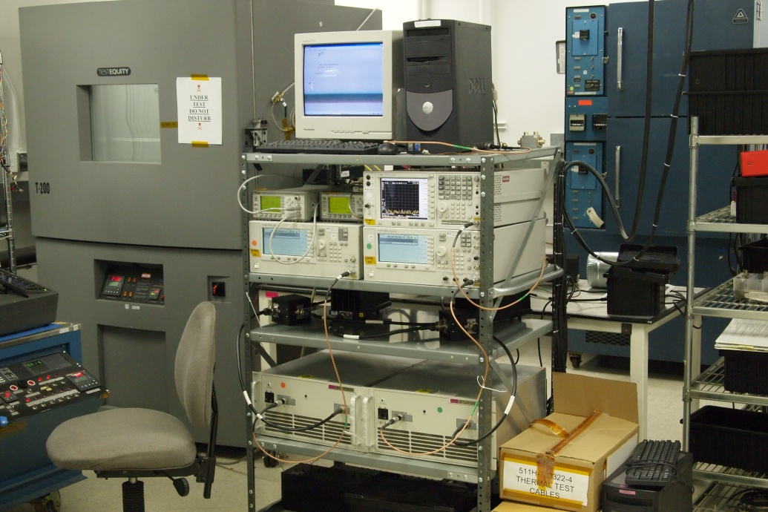
Equipment
Vibration Satiation
PIM Test Station

Slide 26
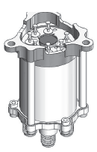
New Switch Qualified
411HQ-730832 Qualification Status
Successfully completed:
  RF & DC functional testing
  Random Vibration
  Sine Vibration
  Mechanical Shock
  Thermal Cycling
  Thermal vacuum
  Life Test, (100,000 cycles)

Slide 27
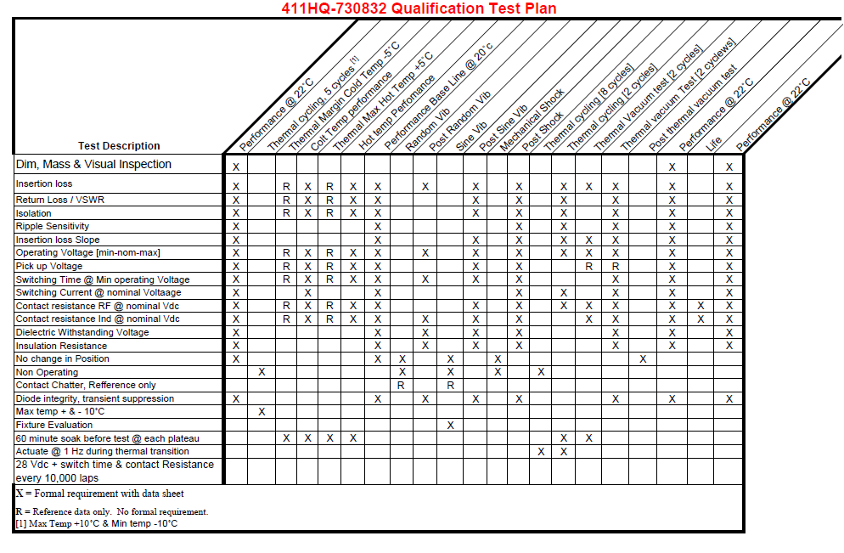
Switch Block Assembly Product Offering

Slide 28
Product Offering
Switches
&
Switch
Blocks
Commercial & Military
Switches
Space Qualified
Switches
Electromechanical Switches
Electromechanical Switches
Waveguide Switches
Waveguide Switches
Matrices
&
Systems
Fiber Optic Matrices
Electromechanical Matrices
O-O-O Solutions
Switching in the Optical Domain
Solid State Matrices
O-E-O Solutions
Switching in the Electrical Domain

Slide 29


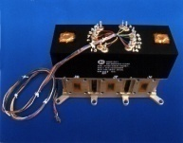
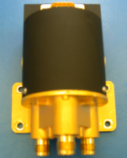
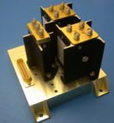

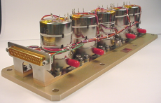
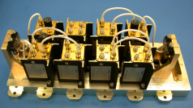
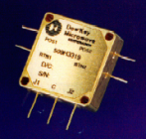

Product Offering
Space Qualified Switches
Electromechanical Coaxial Switches
Waveguide Switches
SPDT (SMA,TNC Connectors)
Transfer Switches
2/3 (SMA,TNC Connectors)
R - Switches
Transfer (SMA, TNC Connectors )
Switch Packs
HP T-Switch (TNC Connectors)
Switch Blocks
And Subsystems
T-Switch (SMA Connectors )
PCB Mount Switches
Iso-Switches

Slide 30
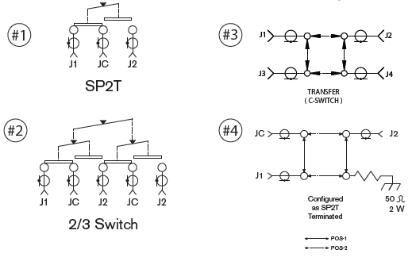
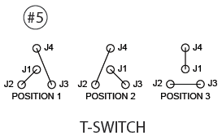
DKM Space Product Offering

Slide 31
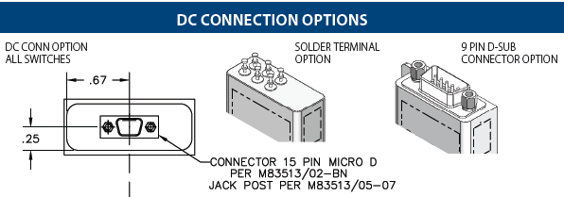
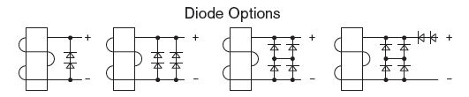
DKM Space Product Offering

Slide 32
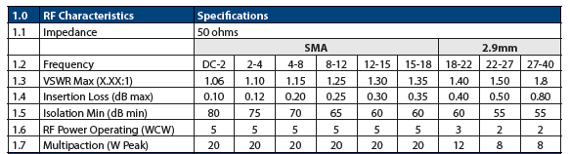
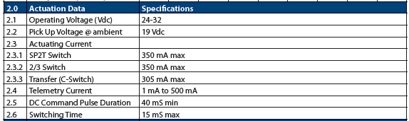
DKM Space Product Offering
Low Power

Slide 33
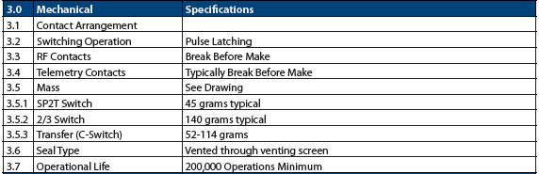
DKM Space Product Offering
Low Power

Slide 34
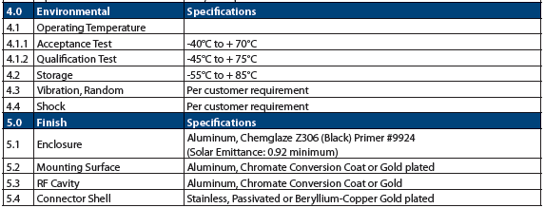
DKM Space Product Offering

Slide 35
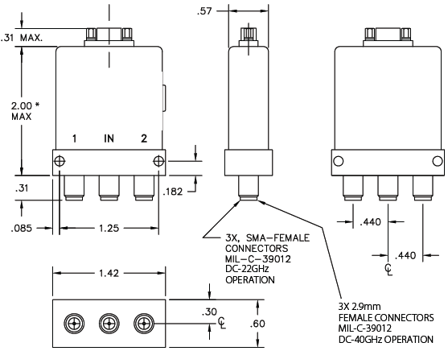
SP2T Switch Product Offering
Low Power

Slide 36
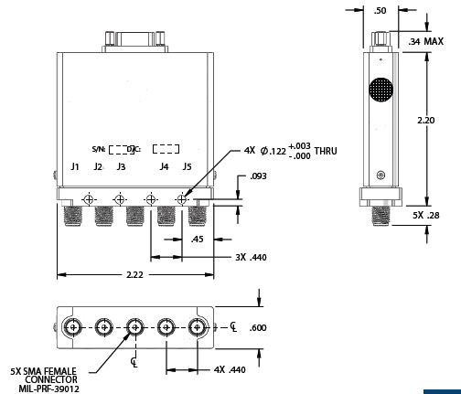
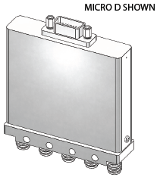
2/3 Switch Product Offering
Low Power

Slide 37
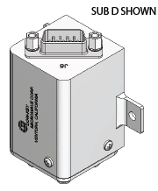
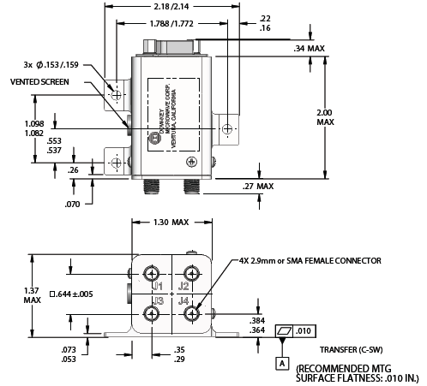
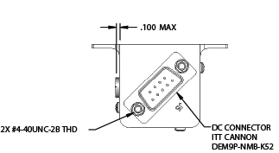
Transfer Switch Product Offering
Low Power

Slide 38
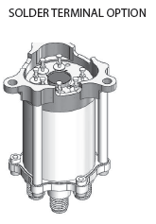
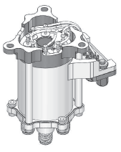
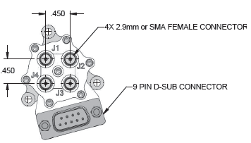
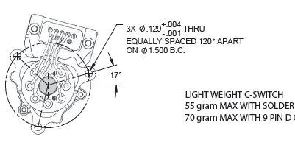
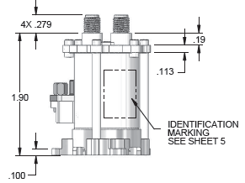
Light Weight Transfer Switch Product Offering
Low Power

Slide 39
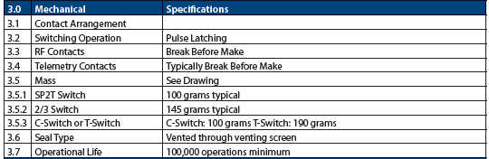
DKM Space Product Offering
High Power

Slide 40
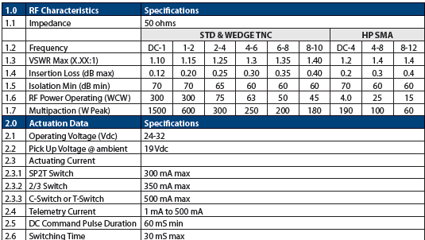
DKM Space Product Offering
High Power

Slide 41
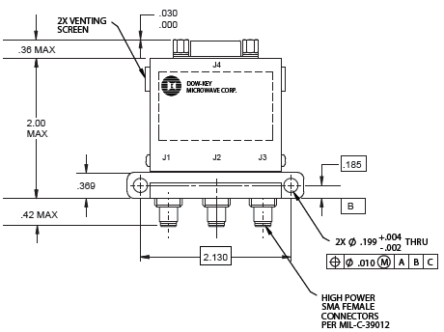
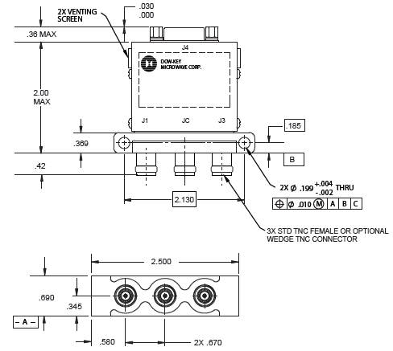
Medium Power SP2T Product Offering
High Power SMA
STD TNC
Wedge TNC

Slide 42


High Power 2/3 Switch Product Offering

Slide 43

High Power Transfer Switch Product Offering
STD TNC
Wedge TNC

Slide 44

Medium Power Transfer Switch Product Offering
High Power SMA

Slide 45

High Power T-Switch Product Offering

Slide 46



Slide 47


Waveguide Switch Product Offering
WR-112 WR-90 WR-75 WR-62 WR-51
WR-42 WR-34 WR-28 WR-22 WR-15
WR-112
WR-15

Slide 48

Waveguide Switch Product Offering
  Switch Waveguide,
  28 Vdc, Pulsed Latching
  Cut away view
Coil
Actuator is isolated
From RF WG section
Rotor

Slide 49


Waveguide Switch Product Offering
Isolated RF Section
no mechanism connected
to the Rotor
Cut a way view showing bearings, Rotor & Magnets

Slide 50


Switch Block Assembly Product Offering
Switch Block Assembly with
Power Dividers, Terminations, Circulators, Attenuators & signal conditioning components

Slide 51
Switch Block Assembly Product Offering
Switch Block Assembly
Coax or Waveguide

Slide 52












Product Offering
Matrices
&
Systems
Electromechanical Matrices
Solid State Matrices
Non-Blocking
IF 20 – 200 MHz
Fan-Out/Fan-In
UHF 20 – 1100 MHz
Switch Systems
L- Band .8 – 2.5 GHz
High Power Systems
C – Band 3.7 – 4.2 GHz
T-VAC Systems
Systems
Filter Banks
PXI/LXI Solutions

Slide 53
Matrix Product Offering
New Generation of Electromechanical
Focus on Modularity and Price Reduction
Reduce NRE Charges for Custom Products
New electrical and software features
Matrix Platforms from 1RU to 4RU.

Slide 54

Product Offering
Power Module is removable from rear of enclosure

Slide 55


New Features
All new electronic components are designed to meet UL , CE, RoHS requirements.
2, 3, 4 U Power Module (Ethernet Version)
New Shielded Ethernet connector for improved EMI
New Shielded CAN bus port for improved EMI and higher amperage.
USB port for remote control.
New feature

Slide 56




1U Matrix Product Offering
Supplied with
4 SP6T, or
5 Transfer
Switches

Slide 57


Custom Product Offering
Fan/Filter
Internal mounting panel for larger switches
Same panel supports as 3U
Fan/Filter
2U/3U/4U Power Module

